Slide 1

https://dribbble.com/shots/15689665-maxew-logo-animation
Make sure the page takes 3 seconds to load – in that 3 seconds mean time – make sure the ManushyaM logo – works as a sample (gif)
The H shall be prominent in that GIF loop

Slide 2
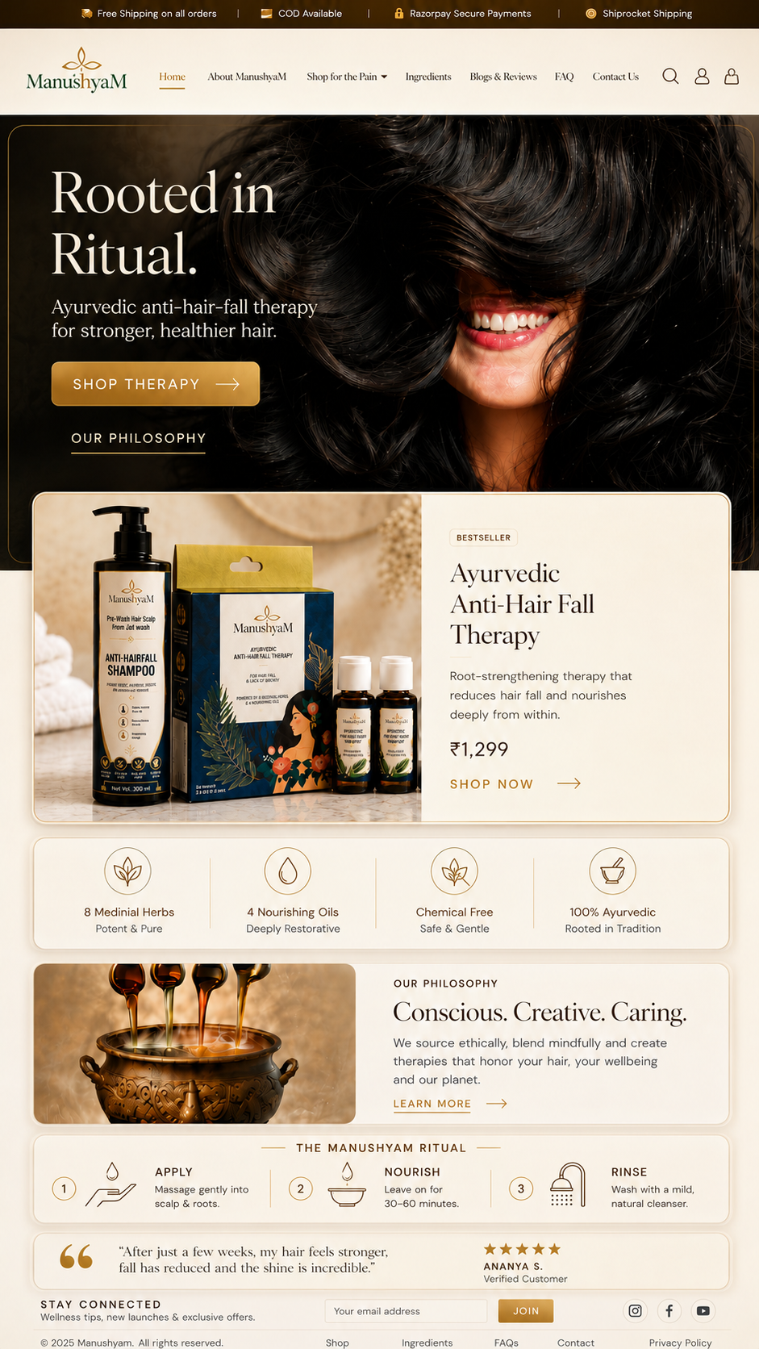




Solutions
HOME PAGE – Landing Page
Now after 4 seconds the logo moves in the corner – and the home page appears

Slide 3

Solutions
ABOUT MANUSHYAM
Now after 4 seconds the logo moves in the corner – and the home page appears

Slide 4

How it works & Ingredients
Now after 4 seconds the logo moves in the corner – and the home page appears

Slide 5
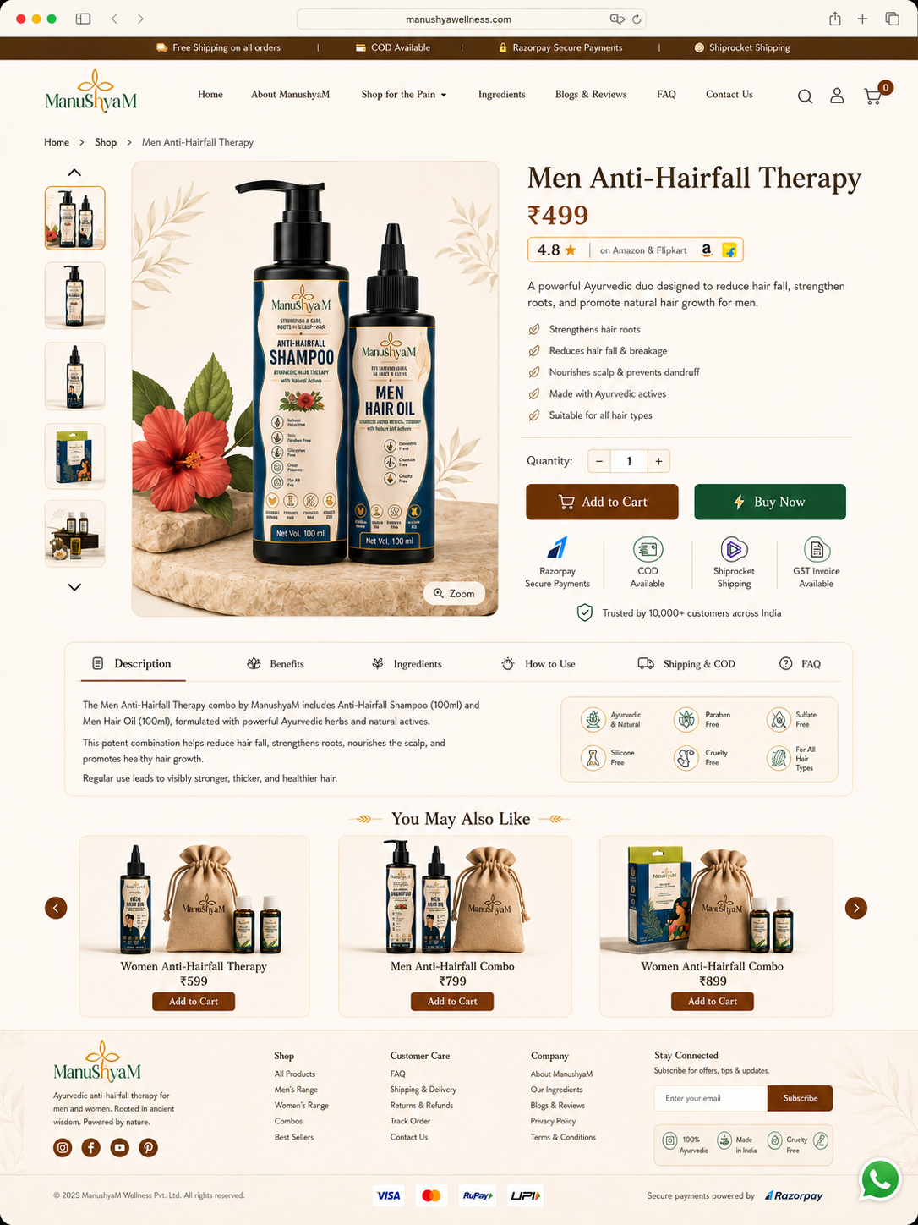
Solutions
Product Page
Men Anti-Hairfall therapy

Slide 6

Solutions
Product Page
Women Anti-Hairfall therapy

Slide 7

Solutions
Product Page
Women Anti-Hairfall Combo

Slide 8

Solutions
Product Page
Men Anti-Hairfall Combo

Slide 9
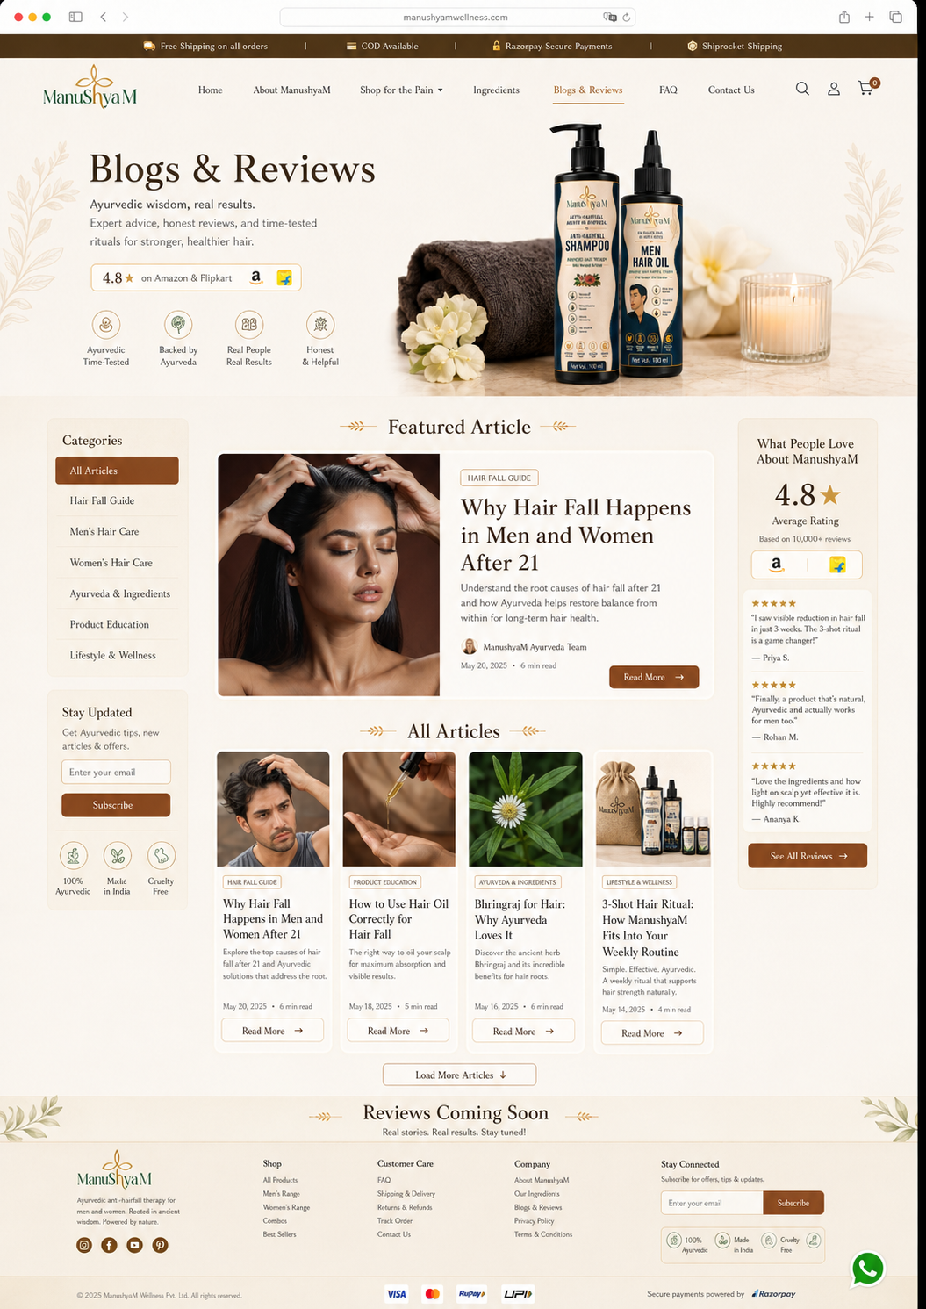
Solutions
Blogs and reviews

Slide 10

Solutions
Payment page

